Slide 1

Big Data Analytics - 13418
W300 B - Fall 22

Slide 2

GROUP 5 PROJECT Presentation

Slide 3

Project Guide
Dr. Mohammad Rawashdeh
Assistant Professor of Computer Science dept

Slide 4





MEET OUR TEAM !
Shrinika Telu
Durga Babu Padam
Mani Teja Mukka
Praveen Kumar Nutulapati
Srujana Maryada
700741742
700726311
700741007
700721987
700742048

Slide 5
Overview
3. Aim & Objective
5. Primary Goals
8. Proposed method
10. Conclusion
1. Title of the project
2. Introduction
6. Technical requirements
9. Results
4. Motivation
7. Timeline

Slide 6

MATRIX
MULTIPLICATION
- MapReduce application

Slide 7
INTRODUCTION
Mapper is a function which process the input data. The mapper processes the data and creates several small chunks of data.
Reducer takes the output of the Mapper process each of them to generate the output.

Slide 8

Aim:
Aim is to Implement a MapReduce application to perform Matrix Multiplication.
Objective :
For Multiplication large scale data we are using MapReduce Code for matrix Multiplication in our project.

Slide 9
Primary Goals :
We have implemented 2*2 matrix initially.
We proceed implementing 3*3
Further improvement in the code we have successfully n*m matrix

Slide 10

Technical requirements
The technical requirements for this project are mentioned below:
a. Hardware Requirements
PC with 2GB Ram
Celeron Processor or Above
b. Software Requirements
Visual studio code ( platform independent )

Slide 11
TIMELINE
Week 1
Planning
Week 2
Designing
Week 3&4
Implementation of code
Week 5
Gathering Input and output sample

Slide 12
Proposed Methods for MapReduce
MapReduce is a technique in which a huge program is subdivided into small tasks and run parallelly to make computation faster, save time, and mostly used in distributed systems. It has 2 important parts:
Mapper: It takes raw data input and organizes into key, value pairs. For example, In a dictionary, you search for the word “Data” and its associated meaning is “facts and statistics collected together for reference or analysis”. Here the Key is Data and the Value associated with is facts and statistics collected together for reference or analysis.
Reducer: It is responsible for processing data in parallel and produce final output.

Slide 13
MapReduce: Overview
Sequentially read a lot of data
Map:
Extract something you care about from each record(keys).
Scan input file record-at-a-time
Group by key: Sort and Shuffle
Reduce:
Aggregate, summarize, filter or transform
Write the result

Slide 14
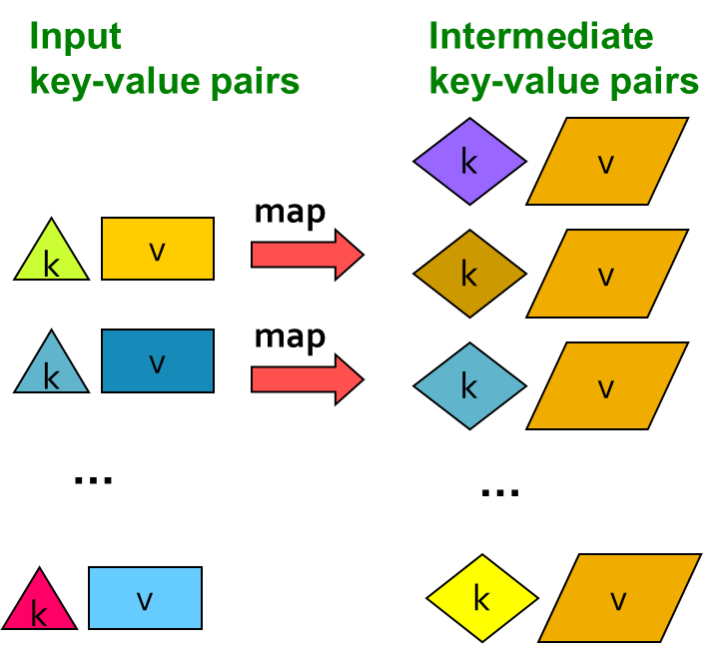
MapReduce: The Map Step

Slide 15
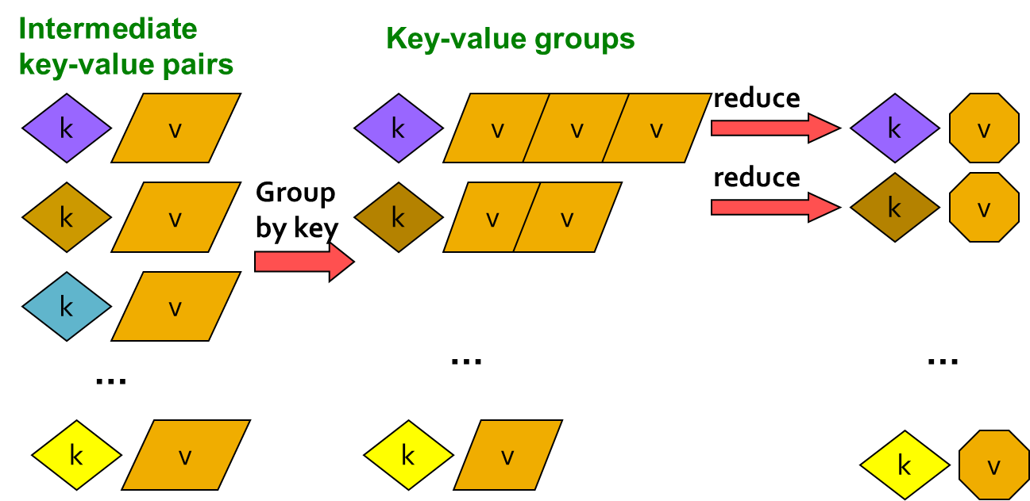
MapReduce: The Reduce Step

Slide 16
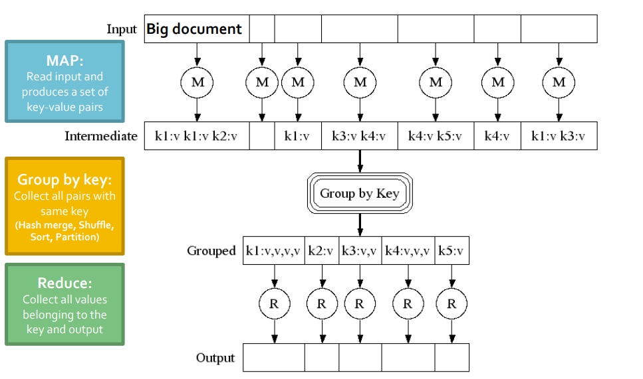

Slide 17
Map-Reduce environment takes care of :
Partitioning the input data
1
Scheduling the program’s execution across a set of machines
2
Performing the group by key step
3
Handling machine failures
4
Managing required inter-machine communication
5

Slide 18
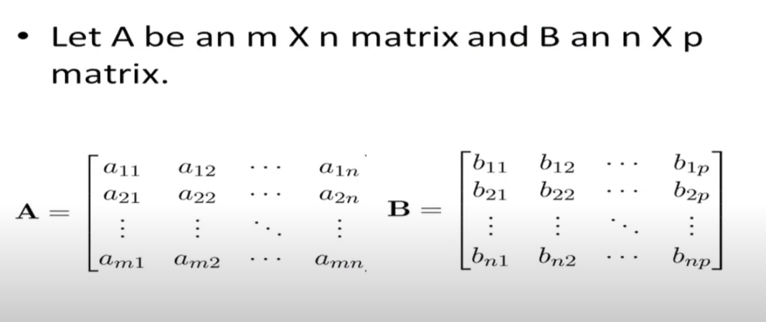

Slide 19
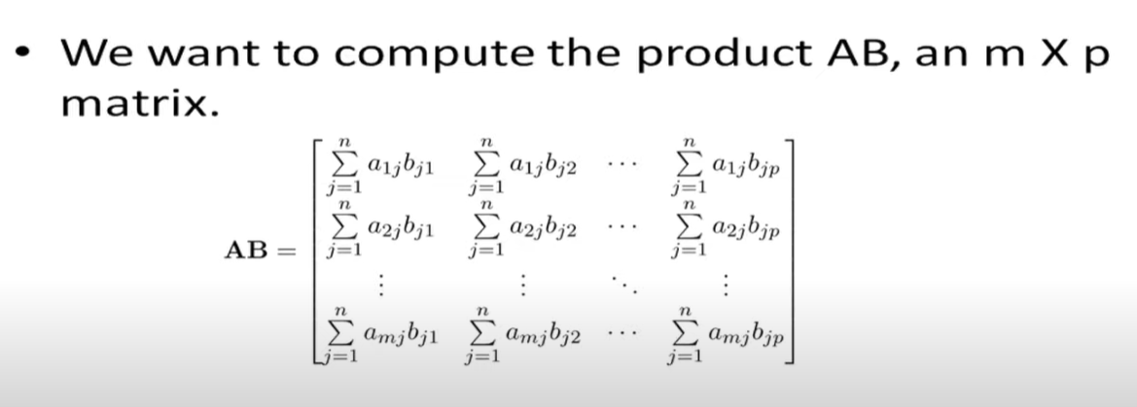

Slide 20
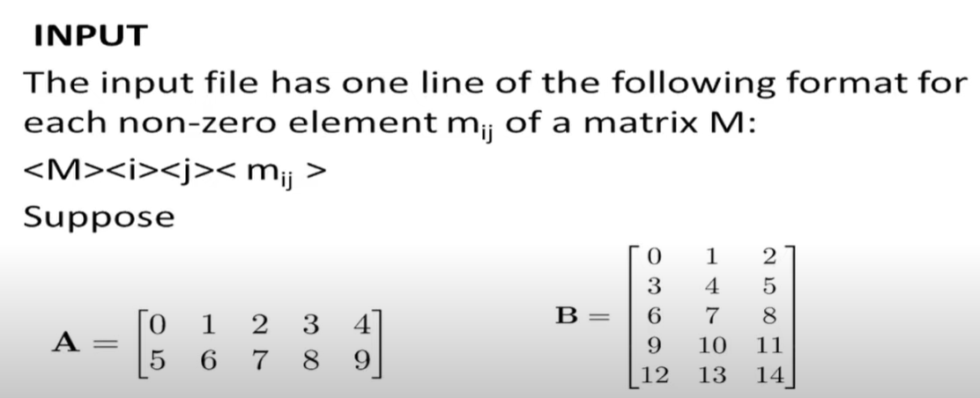

Slide 21
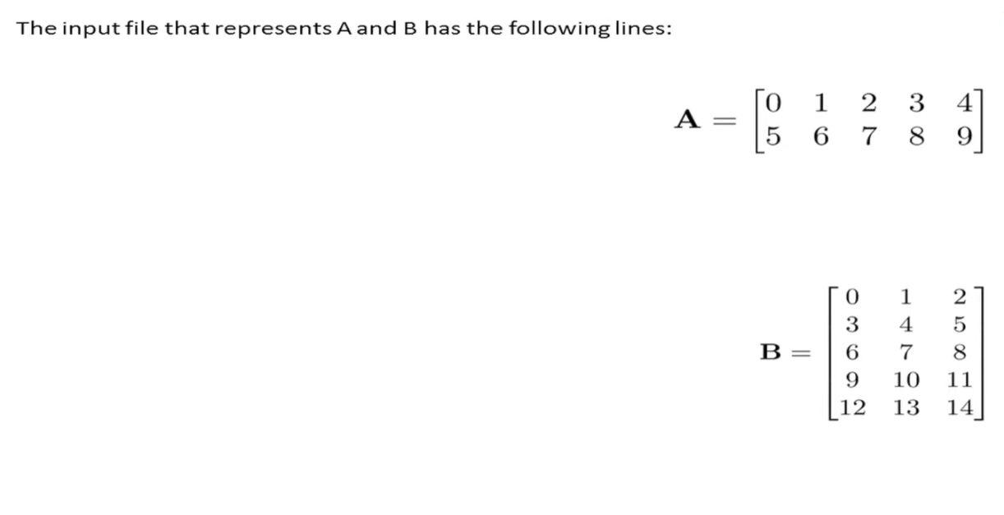
Sample Input Collection
B, 0, 1, 1.0
B, 0, 2, 2.0
A, 0, 1, 1.0
B, 1, 0, 3.0
A, 0, 2, 2.0
B, 1, 1, 4.0
A, 0, 3, 3.0
B, 1, 2, 5.0
A, 0, 4, 4.0
B, 2, 0, 6.0
A, 1, 0, 5.0
B, 2, 1, 7.0
A, 1, 1, 6.0
B, 3, 0, 9.0
A, 1, 2, 7.0
B, 3, 1, 10.0
A, 1, 3, 8.0
B, 3, 2, 11.0
A, 1, 4, 9.0
B, 4, 0, 12.0
B, 4, 1, 13.0
B, 4, 2, 14.0

Slide 22
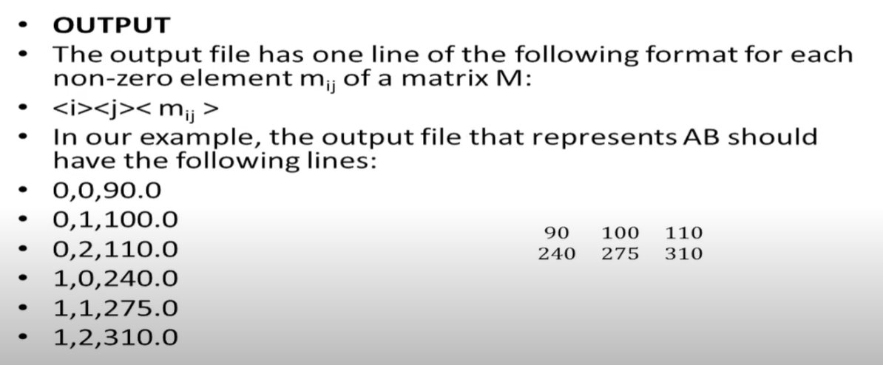
Sample Output

Slide 23
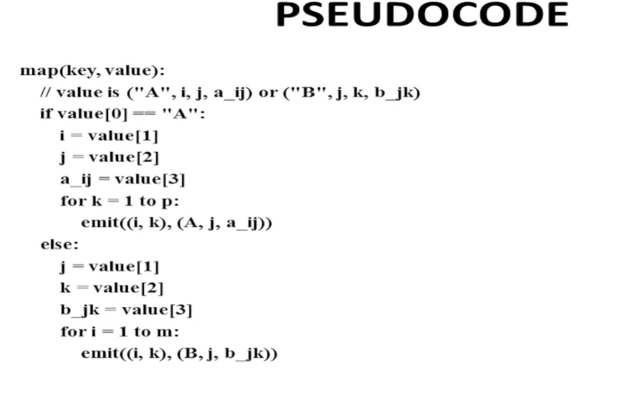
Mapper

Slide 24
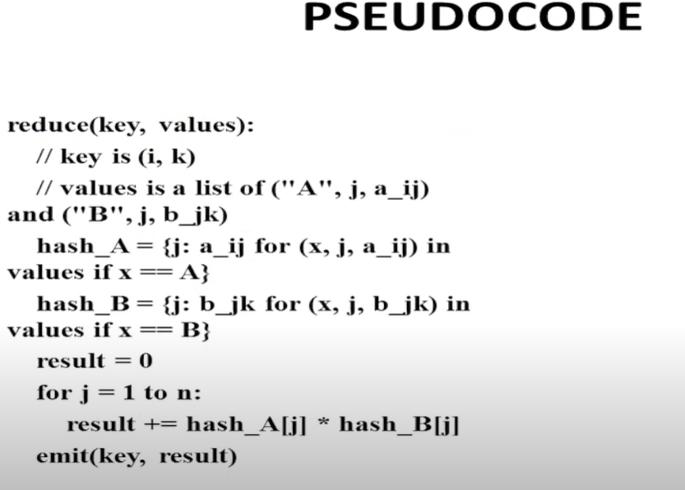
Reducer

Slide 25
Code for Matrix Multiplication

Slide 26
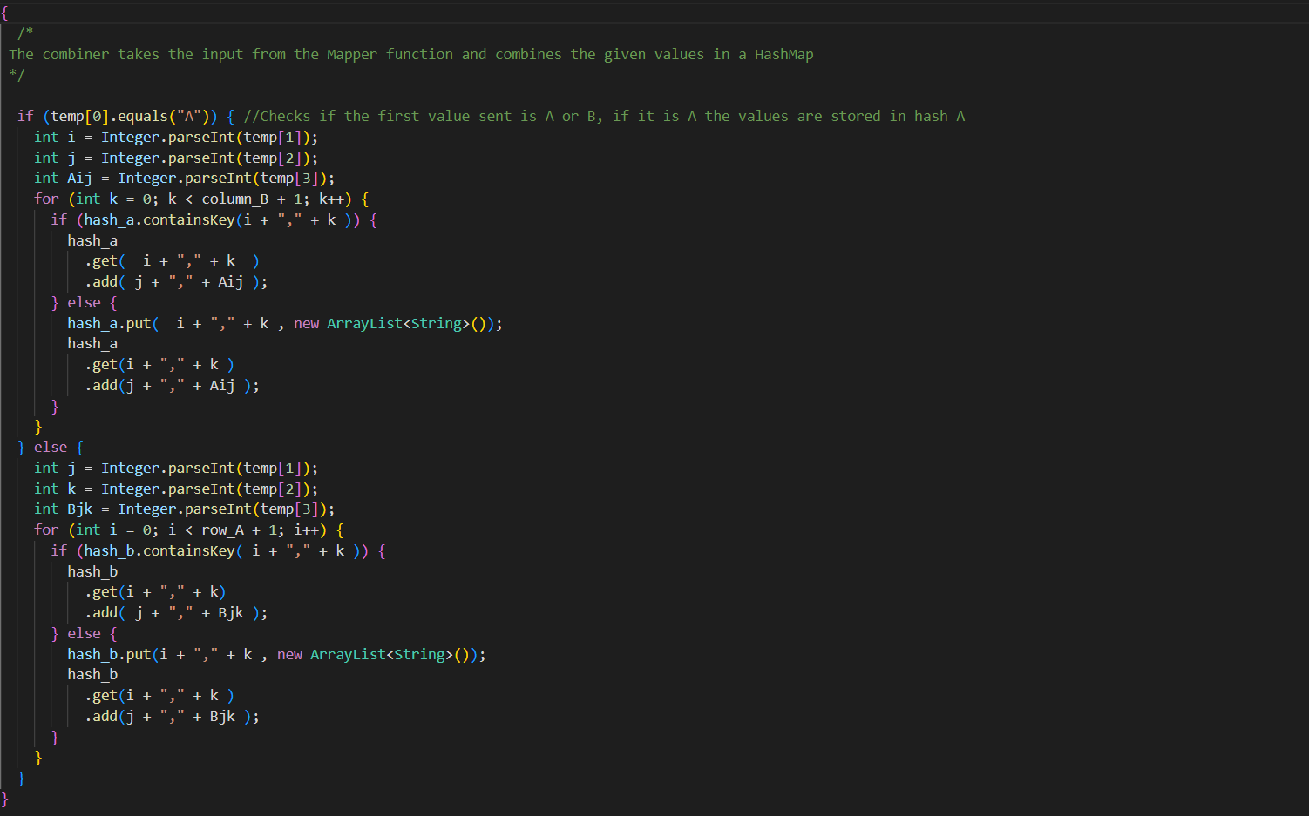
COMBINER function

Slide 27
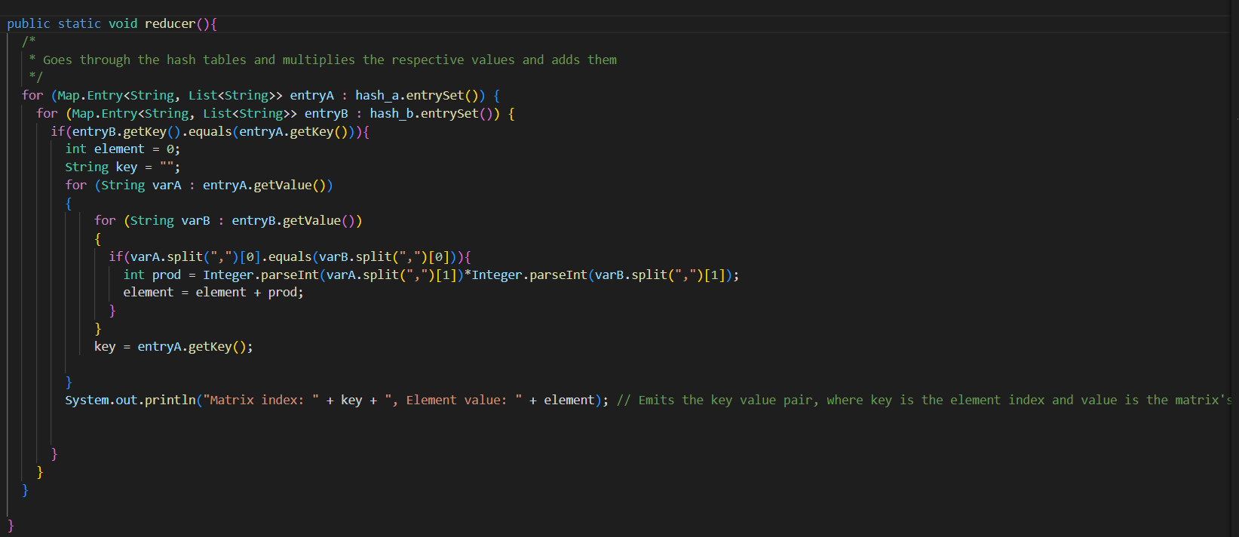
REDUCER function

Slide 28
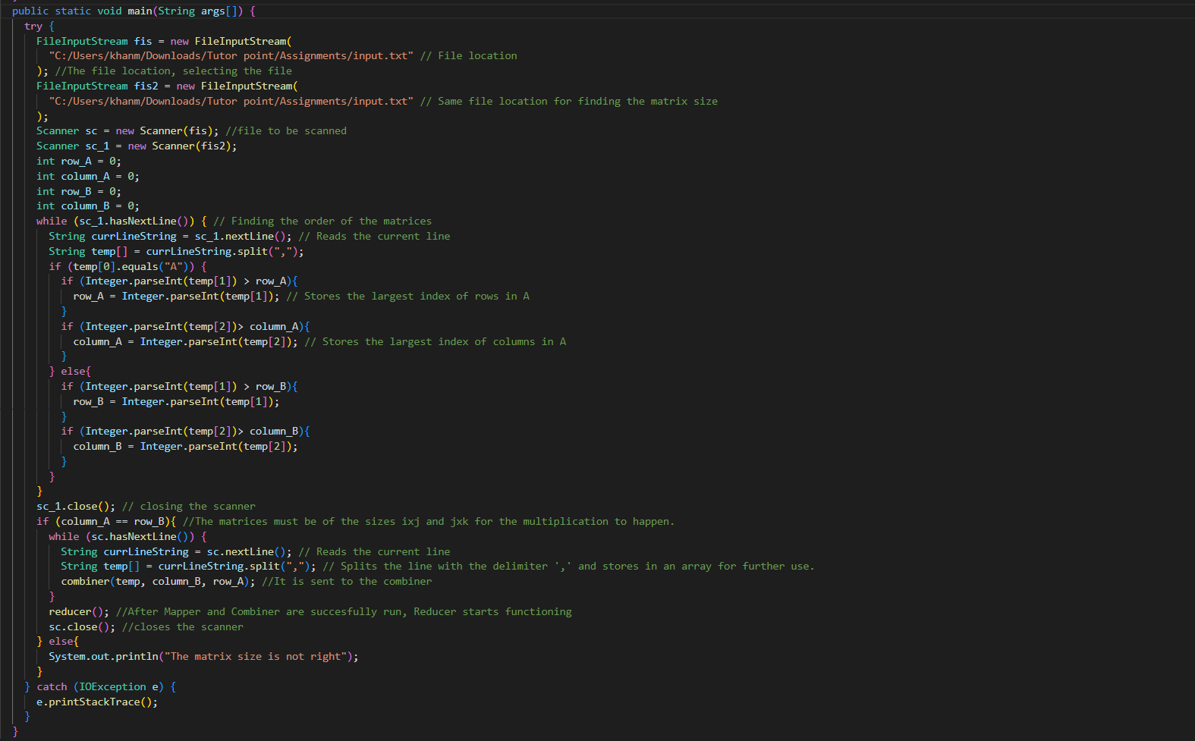
MAIN Map function

Slide 29
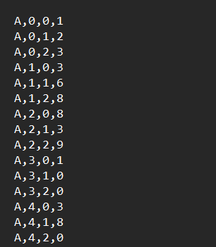
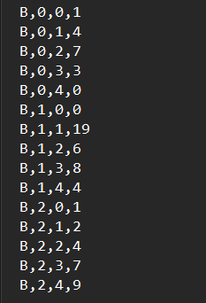
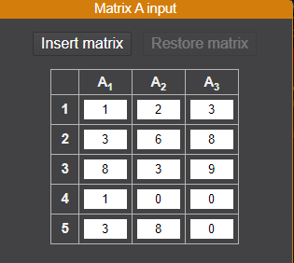
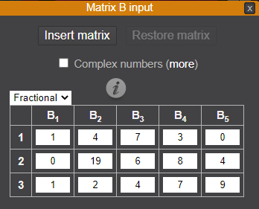
MatrixA - (5 X 3)
MatrixB - (3 X 5)

Slide 30
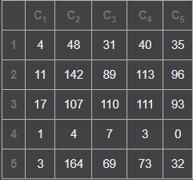
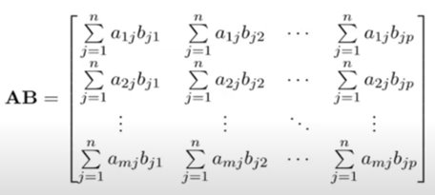
Matrix Multiplication Calculation
c11 = 1 x 1 + 2 x 0 + 3 x 1 = 4
c31 = 8 x 1 + 3 x 0 + 9 x 1 = 17
c51 = 3 x 1 + 8 x 0 + 0 x 1 = 3
c12 = 1 x 4 + 2 x 19 + 3 x 2 = 48
c32 = 8 x 4 + 3 x 19 + 9 x 2 = 107
c52 = 3 x 4 + 8 x 19 + 0 x 2 = 164
c13 = 1 x 7 + 2 x 6 + 3 x 4 = 31
c33 = 8 x 7 + 3 x 6 + 9 x 4 = 110
c53 = 3 x 7 + 8 x 6 + 0 x 4 = 69
c54 = 3 x 3 + 8 x 8 + 0 x 7 = 73
c14 = 1 x 3 + 2 x 8 + 3 x 7 = 40
c34 = 8 x 3 + 3 x 8 + 9 x 7 = 111
c55 = 3 x 0 + 8 x 4 + 0 x 9 = 32
c15 = 1 x 0 + 2 x 4 + 3 x 9 = 35
c35 = 8 x 0 + 3 x 4 + 9 x 9 = 93
c21 = 3 x 1 + 6 x 0 + 8 x 1 = 11
c41 = 1 x 1 + 0 x 0 + 0 x 1 = 1
c22 = 3 x 4 + 6 x 19 + 8 x 2 = 142
c42 = 1 x 4 + 0 x 19 + 0 x 2 = 4
c23 = 3 x 7 + 6 x 6 + 8 x 4 = 89
c43 = 1 x 7 + 0 x 6 + 0 x 4 = 7
c24 = 3 x 3 + 6 x 8 + 8 x 7 = 113
c44 = 1 x 3 + 0 x 8 + 0 x 7 = 3
c25 = 3 x 0 + 6 x 4 + 8 x 9 = 96
c45 = 1 x 0 + 0 x 4 + 0 x 9 = 0
Matrix Multiplication sample output

Slide 31
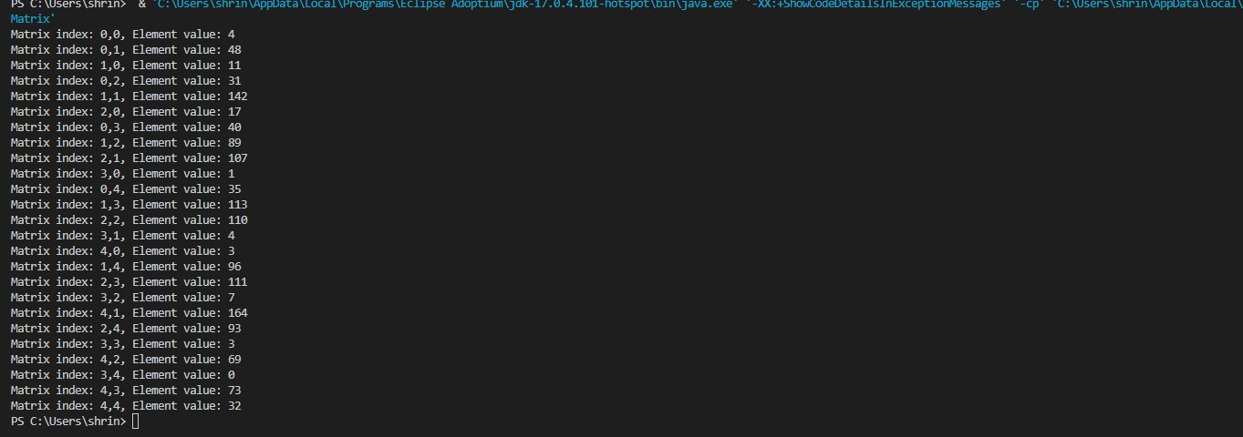
Output Matrix

Slide 32
Product of Matrix A and Matrix B (AB)
 | 0 | 1 | 2 | 3 | 4
0
1
2
3
4
4
48
31
40
35
11
142
89
113
96
17
107
110
111
93
1
4
7
3
0
3
164
69
73
32

Slide 33
SUMMARY
Input: a set of key-value pairs
I.e. MATRIX A and MATRIX B filenames and their respective values
In Program, it specifies two methods:
Map(k, v) ® <k’, v’>*
Takes a key-value pair and outputs a set of key-value pairs
E.g., key is the filename, value is a single line in the file
There is one Map call for every (k,v) pair
Reduce(k’, <v’>*) ® <k’, v’’>*
All values v’ with same key k’ are reduced together and processed in v’ order
There is one Reduce function call per unique key k’
Thus, Product of Matrix a and Matrix B is obtained as output using MapReduce Application.

Slide 34

Thank you

